Slide 1
NODEJS STARTER GUIDE

Slide 2
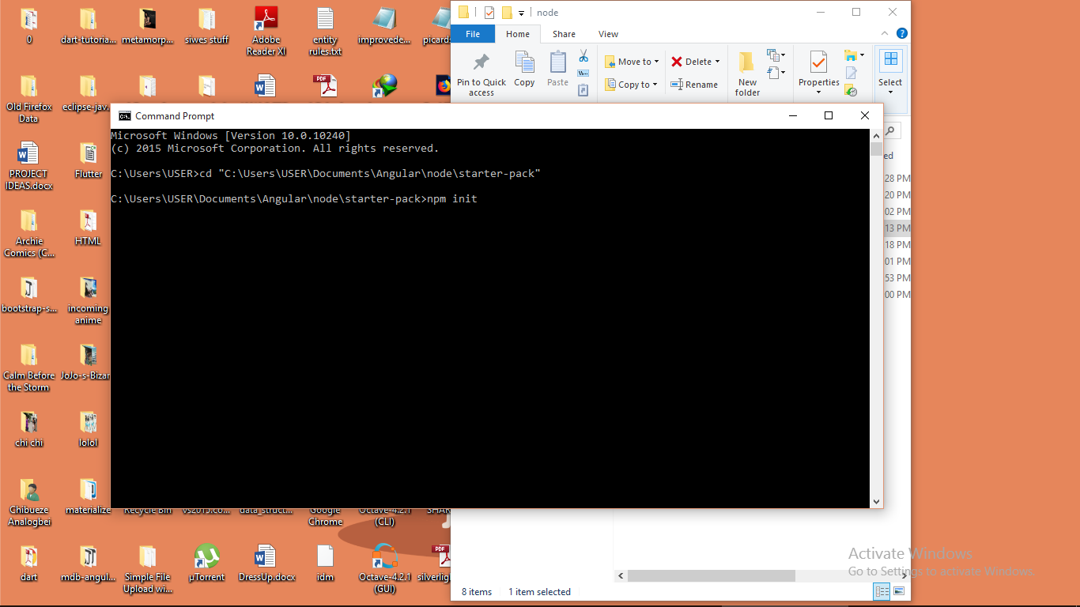
Init NPM on project directory

Slide 3
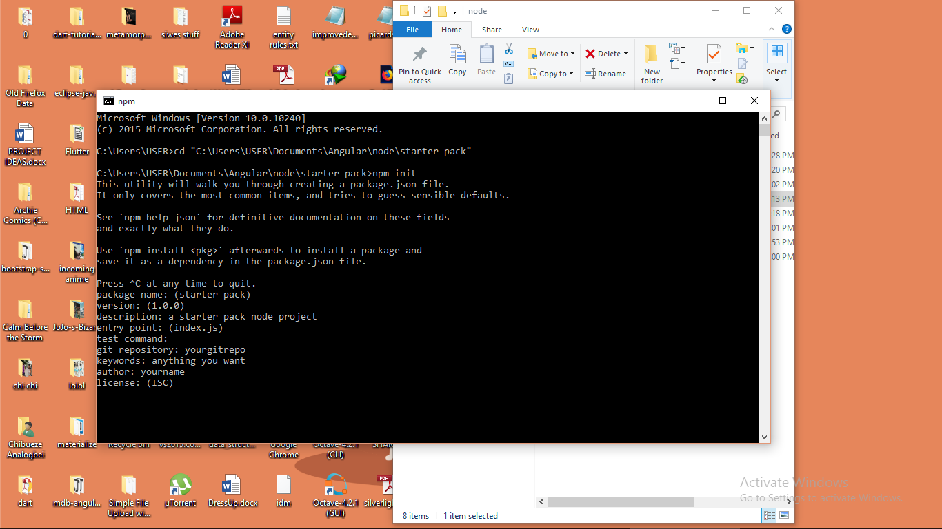
Fill up prompts, press enter to skip/accept default in ()

Slide 4
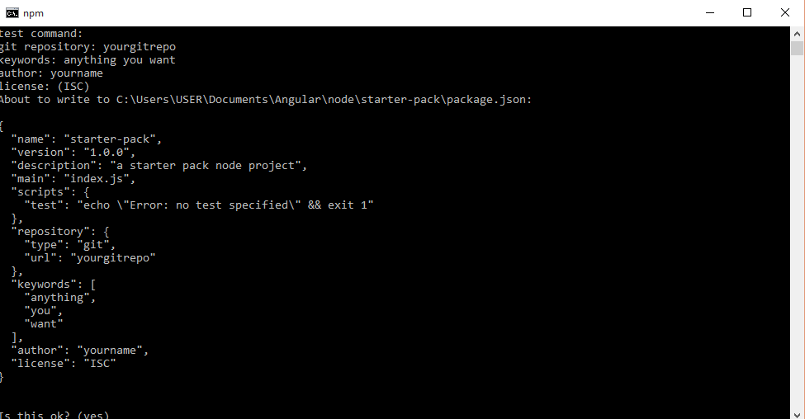
Accept summary by pressing enter, no to change and ctrl+C to terminate at any time

Slide 5
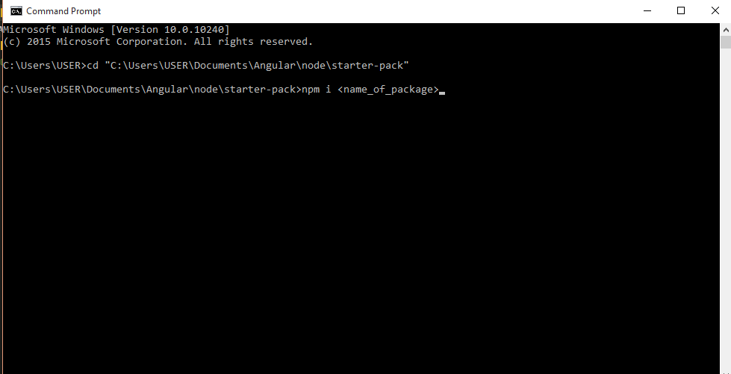
Install packages (on project directory) p.s don’t enclose package name in <> when actually doing it

Slide 6
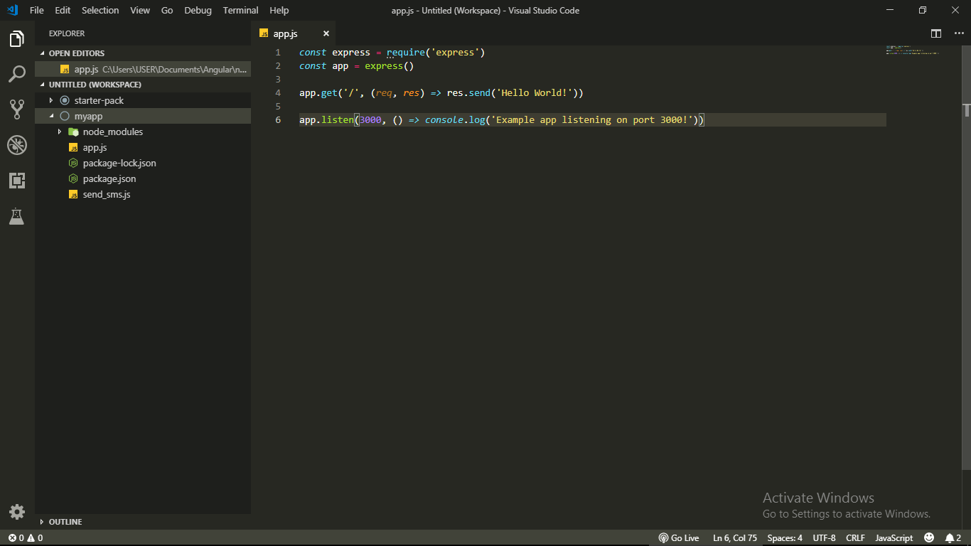
After installing packages, directory looks like that (node_modules and package-lock.json are added). Exclude node_modules from git, you can get it all back if the package json files are available, also beside is a sample code using the express package.(p.s this myapp directory is just an example)

Slide 7
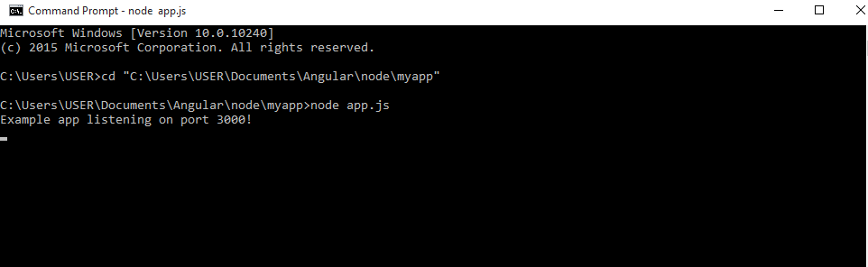
Launch node server from with node(js file), is better if the js file th server is launched from is the entry point file specified in the app creation with npm init, to see if server is working open localhost:3000 on browser

